Slide 1

Exploration

Slide 2

Database
A database is an organized collection of data.
The main purpose of database is to operate large amount of information by storing, retrieving and managing.
There are many dynamic websites on the world wide web nowadays which are handled through databases. For example, a model to checks the availability of rooms in a hotel. It is an example of dynamic website that uses database.

Slide 3
RDBMS
RDBMS (Relational Database Management Systems) is database relational model based, introduced by E.F. Codd (1970s).
In RDBMS, data is represented in terms of tuples (rows). It contains number of tables and each table has its own primary key.
All modern database management systems like SQL, MS SQL Server, IBM DB2, ORACLE, My-SQL and Microsoft Access are based on RDBMS.

Slide 4
SQL
SQL (Structured Query Language) is used to communicate with a database. It’s the standard language for relational database management systems. SQL statements are used to perform tasks such as update data on a database, or retrieve data from a database.
Some common relational database management systems that use SQL are: Oracle, Sybase, Microsoft SQL Server, Access, Ingres, etc.
The standard SQL commands such as "Select", "Insert", "Update", "Delete", "Create", and "Drop" can be used to accomplish almost everything that one needs to do with a database.

Slide 5
PostgreSQL
PostgreSQL, often simply called Postgres, is an object relational database management system (ORDBMS) with an emphasis on extensibility & standards compliance. It’s free & open source, released under PostgreSQL lisence.
Postgres has been developed by PostgreSQL Global Development Group since 8th July 1996, written in C.

Slide 6
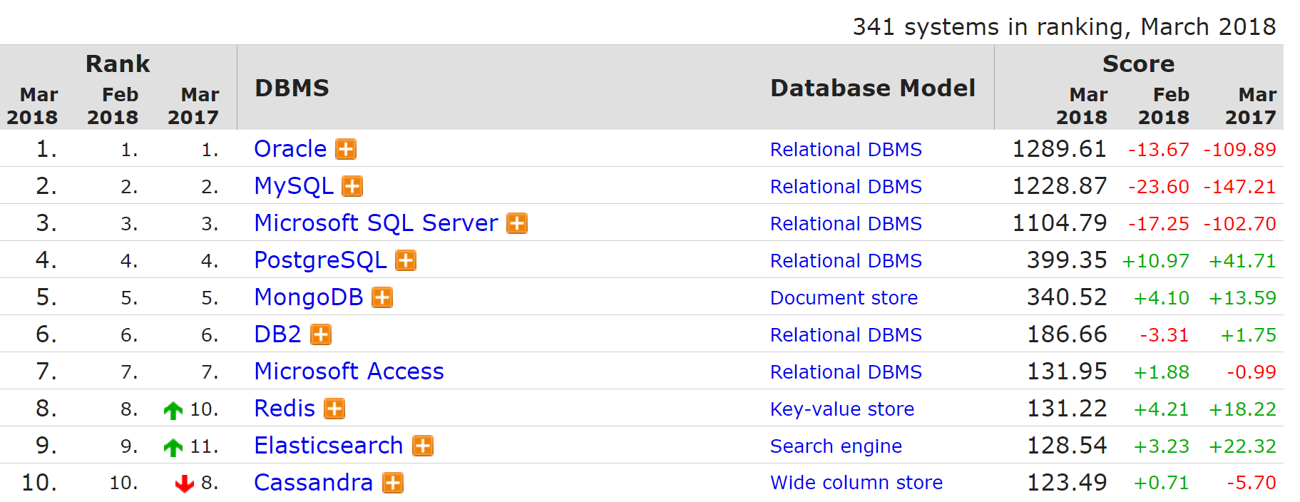
PostgreSQL Ranking
4th All DB-engines
https://db-engines.com/en/ranking

Slide 7
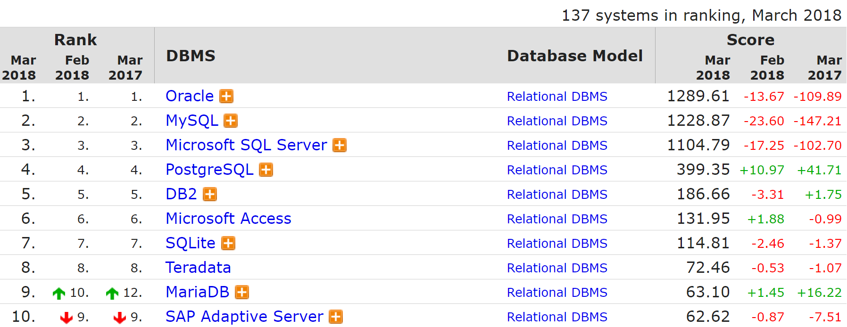
PostgreSQL Ranking
4th RDBMS DB-engines
https://db-engines.com/en/ranking

Slide 8
Getting Started
Download & install PostgreSQL
PostgreSQL Installer
www.postgresql.org/downloads/

Slide 9
Getting Started
Set as super admin, so we can contacting the server easily without any password:
Go to C:\Program Files\PostgreSQL\10\data
Open "pg_hba.conf" then edit its content.
Change "md5" to "trust" & save:
host all all 127.0.0.1/32 trust
host all all ::1/128 trust
host replication all 127.0.0.1/32 trust
host replication all ::1/128 trust

Slide 10
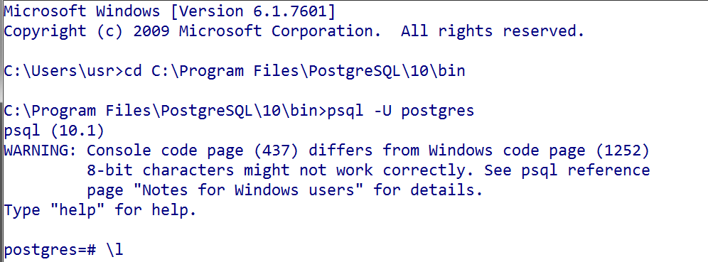
Activate Server #1
Open terminal/command prompt
$ cd C:\Program Files\PostgreSQL\10\data
$ psql -U postgres

Slide 11
Activate Server #2
Open terminal/command prompt
$ cd C:\Program Files\PostgreSQL\10\bin
$ psql -U postgres
//password = 12345

Slide 12
Basic Command
Keluar dari PostgreSQL:
$ \q
Daftar bantuan (help):
$ \h
Daftar perintah (command):
$ \?
Menampilkan daftar database:
$ \l

Slide 13


?
How to Work
With PostgreSQL
Database

Slide 14
Database
Menampilkan daftar database:
$ \l
Membuat database “karyawan”:
$ CREATE DATABASE karyawan;
Hapus database “karyawan”:
$ DROP DATABASE karyawan;
Terhubung ke database “karyawan”:
$ \c karyawan

Slide 15
Table
Membuat table “staf_IT”:
$ CREATE TABLE staf_IT
- (id INTEGER,
- nama VARCHAR (255),
- usia INTEGER);
Menampilkan daftar table:
$ \d
Lihat struktur table “staf_IT”:
$ \d staf_IT
Hapus table “staf_IT”:
$ DROP TABLE staf_IT;

Slide 16
Add Data Record
Insert data ke table “staf_IT”:
$ INSERT INTO staf_IT
- VALUES (1, 'Andi', 24);
$ INSERT INTO staf_IT
- (id, nama, usia) VALUES
- (2, 'Budi', 36);
$ INSERT INTO staf_IT
- (usia, nama, id) VALUES
- (28, 'Caca', 3);

Slide 17
Multiple Data Records
Insert multiple data ke table “staf_IT”:
$ INSERT INTO staf_IT VALUES
- (4, 'Dedi', 42),
- (5, 'Euis', 21),
- (6, 'Fafa', 28),
- (7, 'Gilang', 30),
- (8, 'Hani', 27),
- (9, 'Iwan', 29),
- (10, 'Janni', 28);
Melihat data record di table “staf_IT”:
$ SELECT * FROM staf_IT;

Slide 18
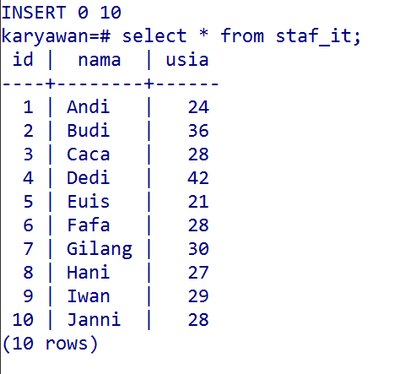
Multiple
Data Records

Slide 19
Select
Menampilkan semua data dari tabel “staf_IT”:
$ SELECT * FROM staf_it;
Menampilkan data nama & usia dari “staf_IT”:
$ SELECT nama, usia FROM staf_it;
Menampilkan hanya data nama dari “staf_IT”:
$ SELECT nama FROM staf_it;

Slide 20
Where
Menampilkan semua data id, nama & usia dari tabel “staf_IT”, yang memiliki nilai usia = 28:
$ SELECT * FROM staf_IT
- WHERE usia = 28;
Menampilkan semua data id, nama & usia dari “staf_IT” , yang memiliki nomor id genap:
$ SELECT * FROM staf_IT
- WHERE id % 2 = 0;

Slide 21
And & Or
Menampilkan semua data id, nama & usia dari tabel “staf_IT”, yang usia=28 atau nama=Andi:
$ SELECT * FROM staf_it
- WHERE usia = 28 OR
- nama = 'Andi';
Menampilkan semua data id, nama & usia dari “staf_IT” , yang memiliki usia antara 24-30:
$ SELECT * FROM staf_it
- WHERE usia > 24 AND
- usia < 30;

Slide 22
Order
$ SELECT * FROM staf_it WHERE
- usia < 29 ORDER BY usia;
$ SELECT * FROM staf_it WHERE
- usia < 29 ORDER BY usia ASC;
$ SELECT * FROM staf_it WHERE
- usia < 29 ORDER BY usia DESC;
$ SELECT * FROM staf_it WHERE
- usia < 29 ORDER BY nama, usia;

Slide 23
Update
Update semua data usia di tabel “staf_IT”:
$ UPDATE staf_it
- SET usia = 26;
Update data tertentu di tabel “staf_IT”:
$ UPDATE staf_it
- SET usia = 32
- WHERE nama = 'Andi';

Slide 24
Delete
Hapus semua data di tabel “staf_IT”:
$ DELETE FROM staf_it;
Hapus data tertentu di tabel “staf_IT”:
$ DELETE FROM staf_it
- WHERE nama = 'Andi';

Slide 25
?
How to Work
With PostgreSQL
GUI Tools

Slide 26
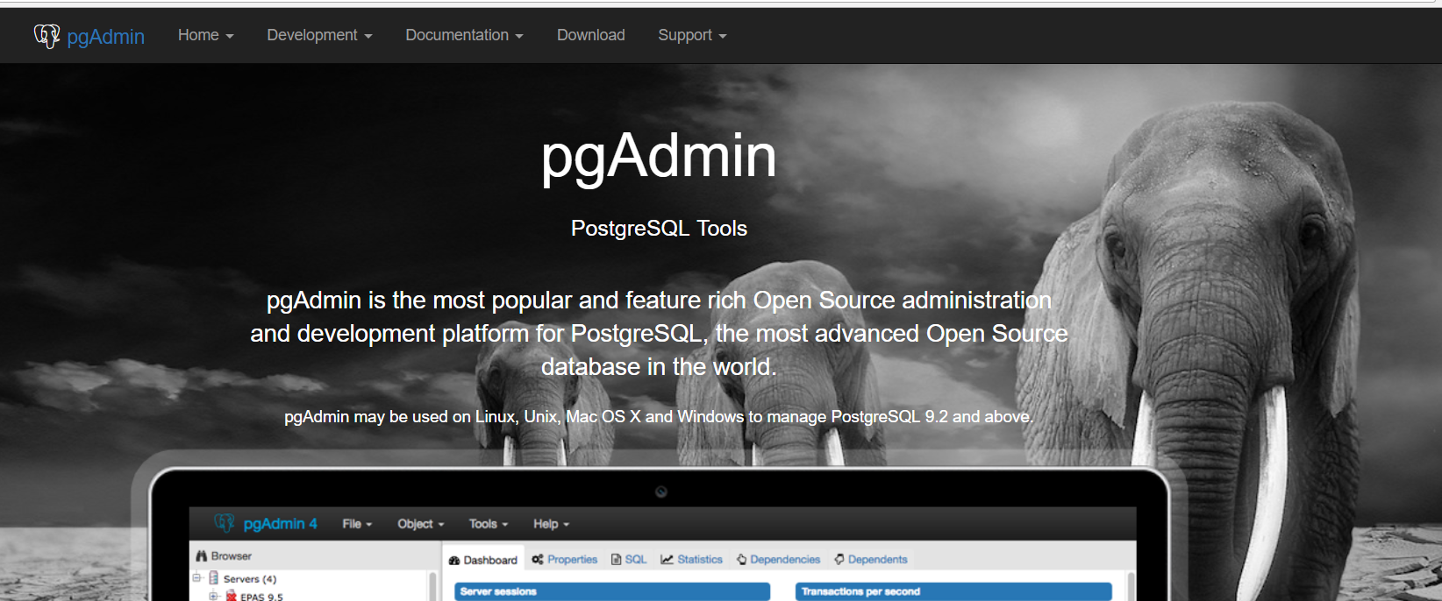
Working with GUI
#1 Installing pgAdmin

Slide 27
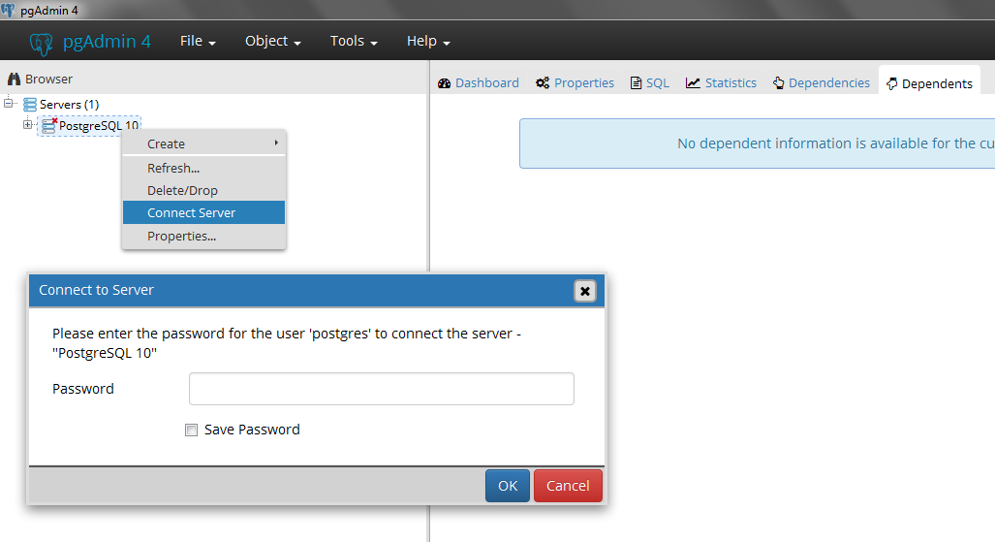
Working with GUI
#2 Connecting Server
Just click OK, if there’s no pass!
*Make sure server is activated first!

Slide 28
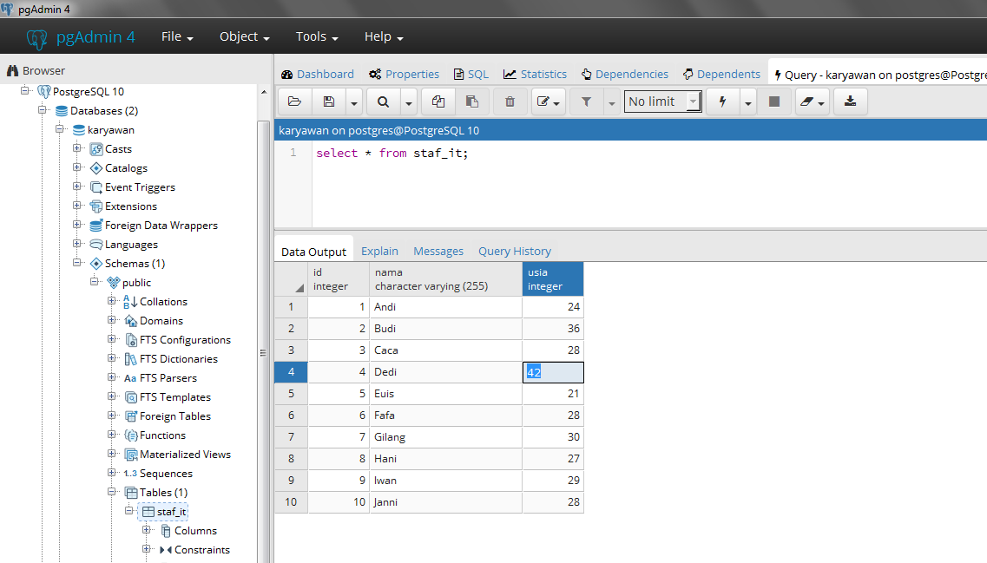
Working with GUI
#3 Tools - Query Tool
Insert query
and execute!
Output query,
edit data directly!

Slide 29
?
How to Work
With PostgreSQL
Hosting

Slide 30

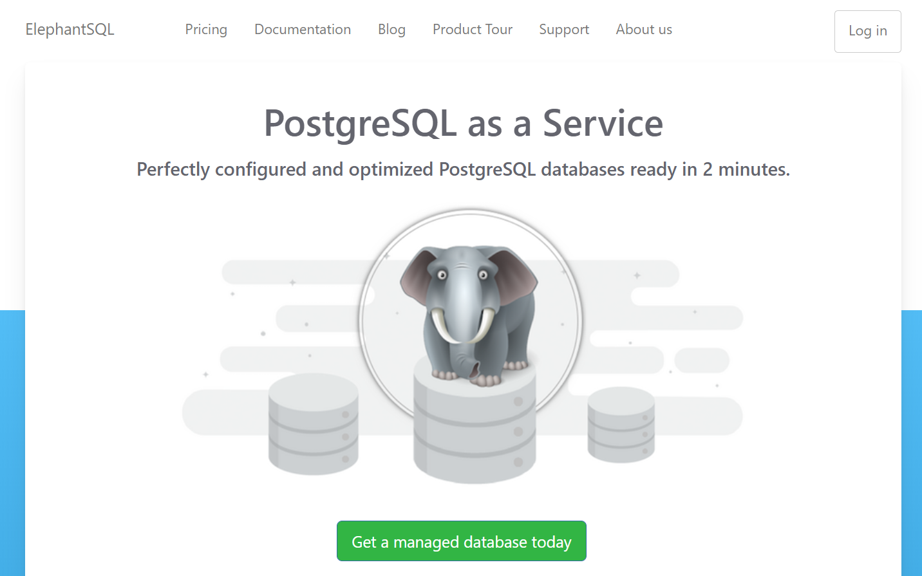
ElephantSQL
elephantsql.com/

Slide 31
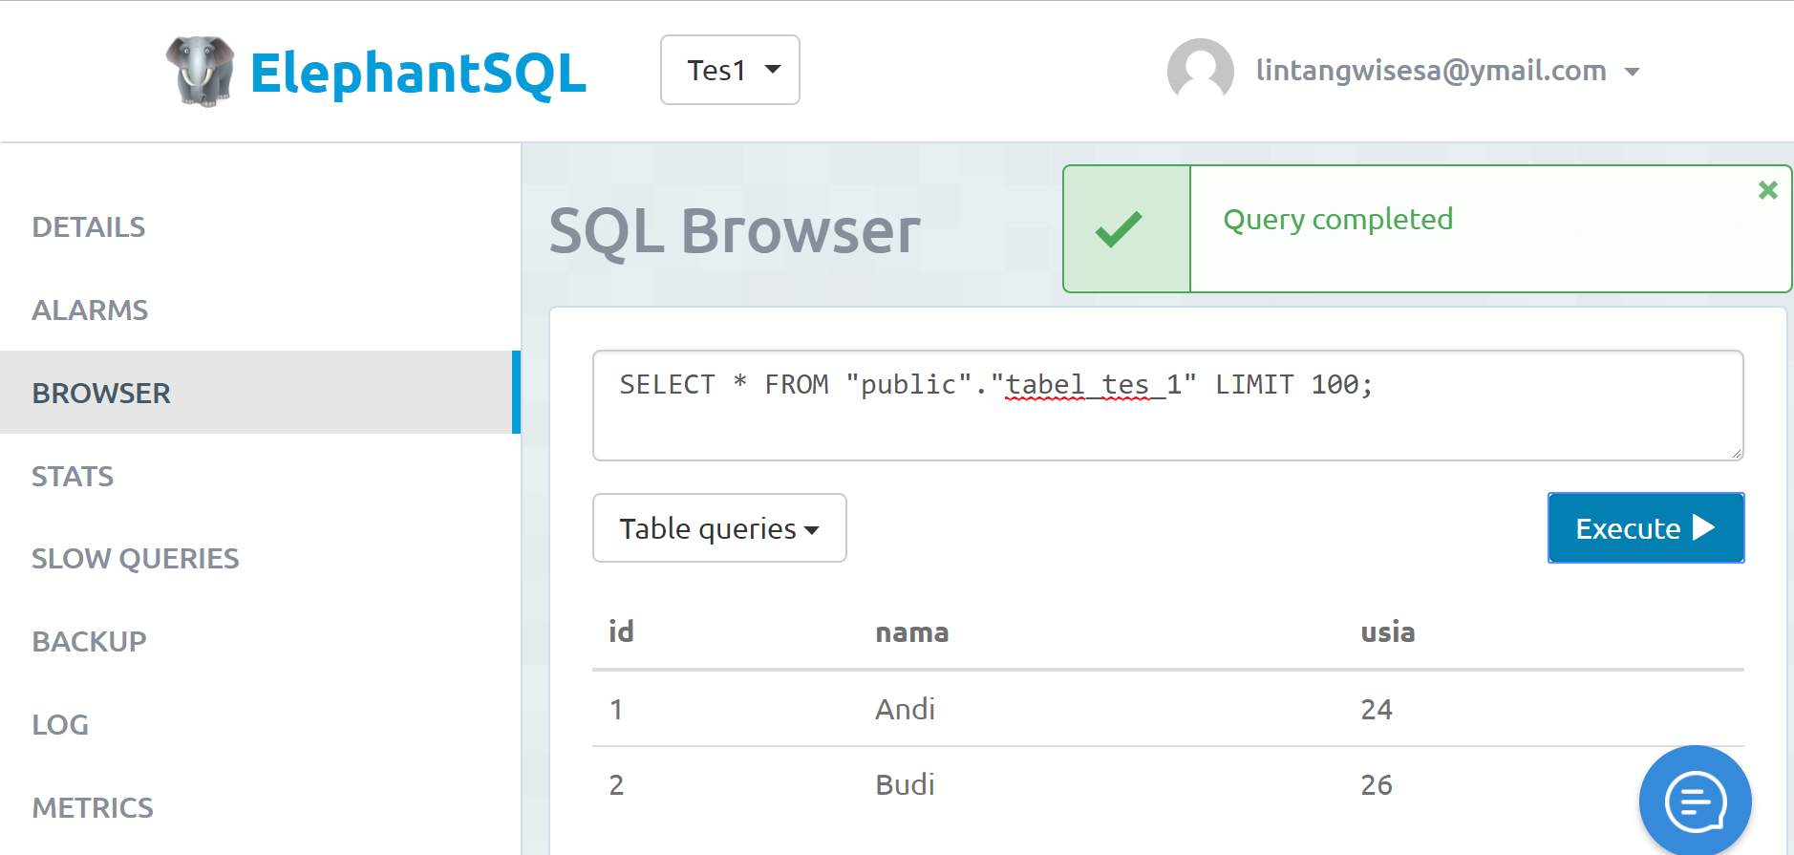
ElephantSQL
elephantsql.com/

Slide 32
Exploration

